Slide 1

Operating Systems for Programmers
Module 3: Memory Management

Slide 2
What is memory management?
OS needs to allocate and deallocate memory before and after execution
OS needs to keep track of used memory space by the processes
Handles Fragmentations issues
Ensures that the memory is being used efficiently as well.
Creates spaces where memory maintains its data integrity to its respective processes

Slide 3


Physical and Logical Address Spaces
Memory can be broken down into 2 different spaces
Physical Addresses
A Physical address is seen by the MMU
Can be called the ”Real Address”
Address is constant
Logical Addresses
This is the address assigned by the CPU, and can be called the Virtual Address
Logical addresses can be changed

Slide 4
Concept: Swapping
For a process to be executed, it must be in memory
Swapping is a way to temp. place a process into secondary memory so that more processes can be run and fit into memory at one time.
A bulk of the time is transfer time ( switching from the slower secondary mem, to the much faster main mem. )
Roll-in-roll-out – because higher priority processes arrives and wants service, the memory manager can swap out the LowP processes and then place HighP ones.

Slide 5
contiguous memory allocation
A classical allocation model where a system design consecutive memory blocks ( consecutive addresses ) to a process
One of the oldest methods
How does it work?
When a process needs to execute, it requests memory.
The size of the process is compared with the amount available to that process.
When enough is found, the memory is allocated and the process is free to execute

Slide 6
contiguous memory allocation
Works with the help of 2 registers knows as the base and the limit
The Base register is the starting address of the memory location
The Limit register is the number of bytes consumed by the process

Slide 7
contiguous memory allocation
Benefits
Tends to be faster and easier for the OS to handle with less overhead
Drawbacks
Memory can be wasted this way
Can lead to longer execution

Slide 8
principles and limitations of memory allocation
Two main types – Static and Dynamic
Static allocates memory BEFORE its execution
Dynamic allocates DURING its execution
Assigning a space to a process is called “memory allocation”
General aspect of the term binding

Slide 9
Static
Static loading a process into memory loads the entire program into a fixed address ( static* ) This requires more memory space
If data sizes are knot known, they have ot be guessed
Because this is loaded, it can lead to faster execution of a process
But, also leads to wasted memory

Slide 10
Dynamic
Dynamic loading is a little different
The entire program must be in physical memory, so the process is limited by the size of the physical memory.
Dynamic loading allows to only load when it is needed – they are stored as a relocatable format
Unused routines are never loaded – which saves on
Memory space

Slide 11
Memory Allocation Cont.
2 Partitions for
User processes
Resident OS
Multiple Partition Allocation
Selected from the queue and loaded into a free partition – when the process terminates, the partition becomes available for other processes

Slide 12
Memory Allocation Cont.
Fix Partition Allocation
OS Maintains a table that indicates which parts of memory are available and whchi are occipiued
Initially all memory is available for user processes and considered a single large block. AKA…. A Hole. ( original )
When a process needs memory, the OS searches for a hole to put it in. However, there are some dynamic storage allocation problems that can occur. Where do you put a process?

Slide 13

First Fit
Starts at the beginning, and finds the first hole that the process would fit in.

Slide 14

Best Fit
Searches the all the memory, to find the smallest but best block that the process can go in.
Best for overall memory allocation efficiency ( time concerns however )

Slide 15
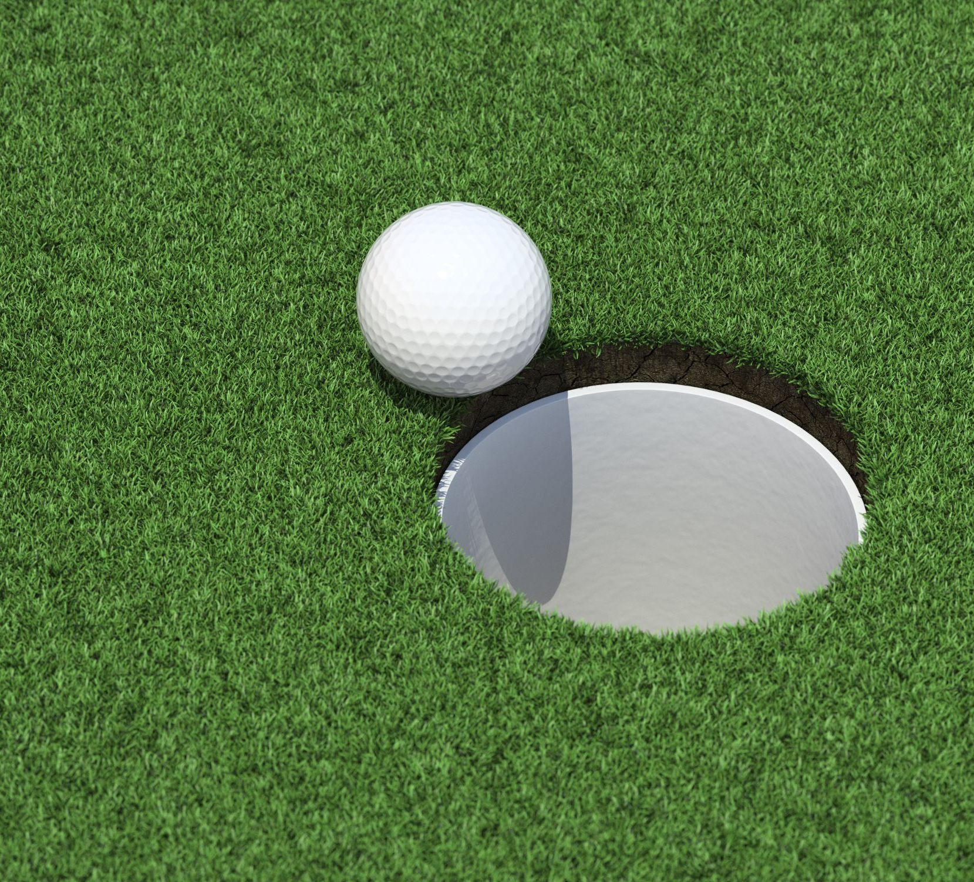
Worst Fit
Allocates the largest possible hole to a process
Produces the largest left over hole as well.

Slide 16
Leads to various types of Fragmentation
When processes are allocated and deallocated and starts to leave small free holes.
These holes can not be allocated to processes because they are not big enough
To achieve a degree of multiprogramming, we must reduce waste generated by memory allocation

Slide 17

Internal Fragmentation
When memory blocks are allocated to a process are more then is needed by the process
Fixed partition – When breaking into 6kb blocks
Process needs 4kb, but the block is 6kb resulting in a 2kb waste

Slide 18
External Fragmentation
When we have a free memory block, but cannot assign it to a process because blocks are not contiguous
Happens in dynamic memory allocation
First-fit and –best-fit systems are affected by this type of fragmentation
Solution: Compaction– all free memory combines to make one large block, so that other processes can use it effectivly

Slide 19
segmentation
Dividing a process into segmentations which are not all of the same sizes.
Sometimes called segments
Gives user a view of the process which paging is not
Users view of the segments is mapped to physical memory
Stored on a Segment Table – Maps 2-D logical address into 1-D physical address.
Has a base address and a limit address ( Limit always defines the length of an address space.

Slide 20

Segmentation
Advantages
No internal fragmentation
Segment Table consumes LESS space in comparison to a paging table
Disadvantages
As processes are loaded and unloaded, the free memory is broken into little pieces… causing External Fragmentation

Slide 21
Paging
Memory Management Scheme that eliminates the need for contiguous allocation of physical memory
Permits the address space to be non-contiguous
OS maintains a Page Table
Frame is a block of physical memory – Physical address space
Page is a logical address space ( virtual )
Page Size == Frame Size

Slide 22
Pages & Frames
Page address
Page number
Page offset
Physical Address
Frame number
Frame offset

Slide 23
Other Types of Page Tables
Inverted
One page table for every frame in memory
Clustered
Like a hashed page table, except each entry refers to other hashed tables
Forward Mapped
AKA a 2-level paging example – Table is further divide

Slide 24
Page table can also be done with hardware
Done with dedicated registers, but only if the page table is small
If large number of entries, can ise a TLB, a special fast look up hardware cache
TLB is associative High Speed memory
Consists of 2 parts – A tag and a value
TLB reach is the number of entries x the page size

Slide 25
memory protection
Protects OS form user processes by using a relocation reg. and a limit reg.
The relocation reg. has the value of the smallest physical address and the limit reg. has the range of the logical addresses
Logical address < Limit reg.
MMU used to translate the value of the relocation reg. dynamically

Slide 26
Needs for Protection
Prevents processes from accessing unallocated memory- stops software from seizing control over a very large amount of memory ( that’s why its assigned a limit )

Slide 27

What is Virtual Memory?
Storage allocation scheme where secondary can be addresses as if it were part of the main memory
The addresses a translated automatically to the corresponding machine address.
Limited by the amount of secondary memory available, not by the number of main storage locations

Slide 28

Virtual Memory
Implemented using both hardware and software
Virtual addresses are mapped to physical addresses in computer memory
Logical addresses are dynamically translated into physical addresses at runtime

Slide 29

Page Replacement Algorithms
FIFO
Optimal Page
LRU
MRU

Slide 30
First In First Out ( FIFO )
Simplest replacement algo
OS keeps track of all pages in the memory in a queue – where the oldest page is in the front of the queue
When a page needs to be replaced, the page in the front is selected for removal
Belady’s anomaly proves that it is possible to have more page faults when increasing the number of page frames while using the First in First Out (FIFO) page replacement algorithm.

Slide 31
Optimal Page Replacement
Pages are replaced which would not be used for the longest duration of time in the future
Optimal page replacement is perfect, but… not practical because the OS would have to know the future. And I would be a Mega-Millions winner if it could do that!

Slide 32
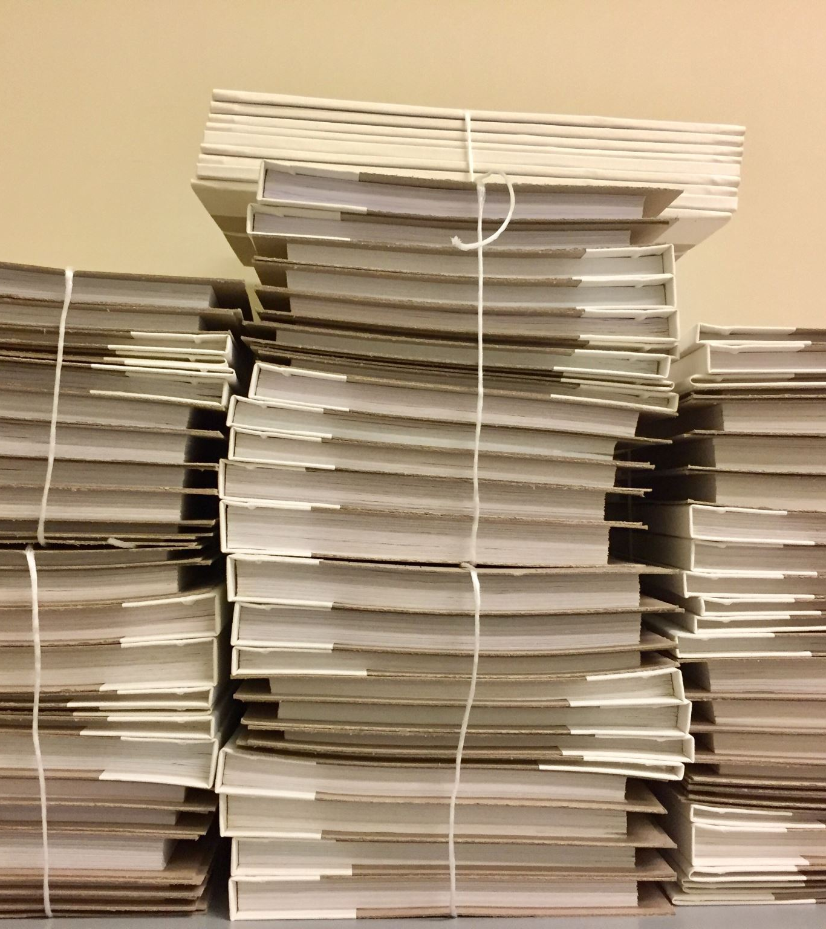
Least Recently Used
Pages are replaced by the less frequently used ones being removed first

Slide 33
Most Recently Used
Pages replaced which have been recently been used.
Beladys anomaly can occur with this algorithm

Slide 34
What is Belady’s anomaly?
The phenomenon in which increasing the number of page frames results in an increase in the number of page faults for certain memory access patterns. This phenomenon is commonly experienced when using the first-in first-out (FIFO) page replacement algorithm.
In FIFO, the page fault may or may not increase as the page frames increase, but in optimal and stack-based algorithms like LRU, as the page frames increase, the page fault decreases.

Slide 35
Working Set Model
All previous Page Replacement Algos ( FIFO, LFU, MFU, Optimal ) are local page replacement algorithms.
The algos can lead to Thrashing
The Working Set model is based on pages referenced in the most recent Delta
If a page is being used, it will be in the working set, If it is not, it will be labeled with delta time units after its time reference
Working set is a reference to its locality ( approximation )

